Slide 1

Data Provenance in the Research Lifecycle: Report from the Trenches + some thoughts on reproducibility when data are not publishable
Lars Vilhuber
Cornell University
February 2021
The opinions expressed in this talk are solely the authors, and do not represent the views of the U.S. Census Bureau, the American Economic Association, or any of the funding agencies.
© Lars Vilhuber .

Slide 2
Access: By whom?
Researcher

Slide 3

Access: By whom?
Researcher

Slide 4

Access: By whom?
Academia?
Researcher

Slide 5
Access: By whom?
Researcher
Research Community?

Slide 6
Access: By whom?
Researcher
Small
Research Community?

Slide 7
Themes
Importance of tiered access
Recognition that not all data can be made “public”
How to better handle access requests
Support for private datasets
Importance of non-academic data providers (commercial, ad-hoc)
Importance of university data retention policies and infrastructure
Meta-repositories
Or: how to see all deposits that relate to a journal’s articles
APIs:
Better information about deposits
Easier computational integration

Slide 8

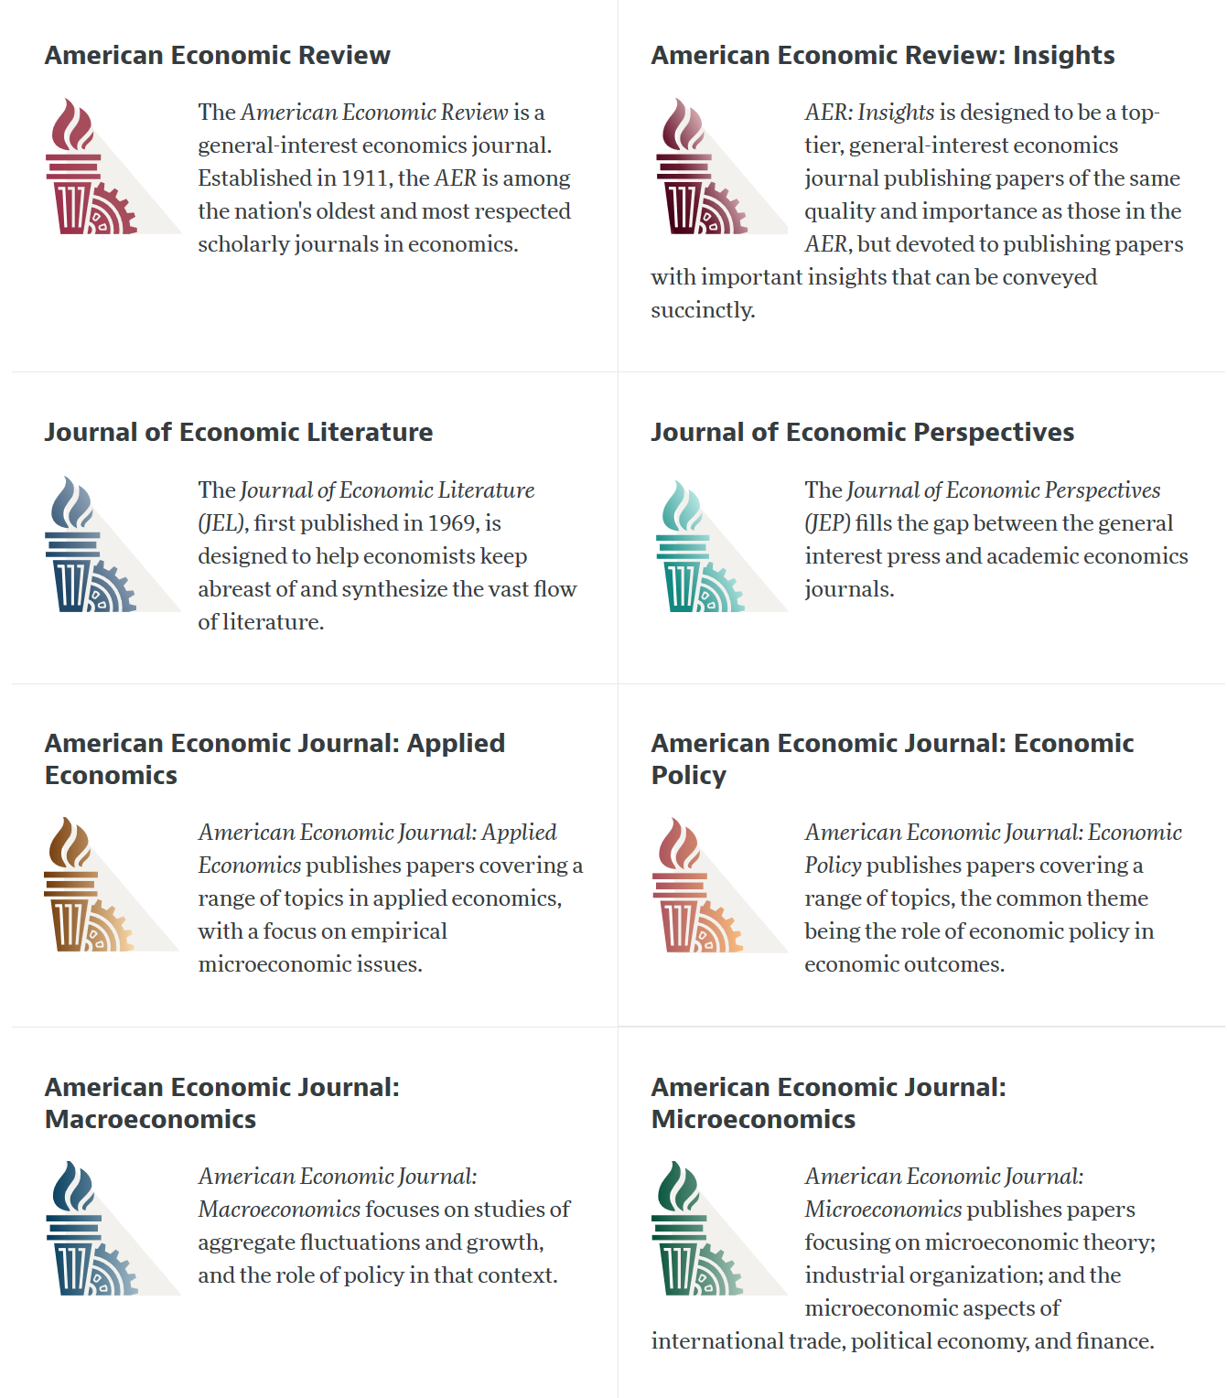
Current efforts at the AEA
Pre-emptively improve code archives
By conducting reproducibility checks when we can
By working with groups that conduct reproducibility checks when we cannot
Better archives
Greater transparency of the code and data archives
Better provenance tracking
Leave code where it is when appropriate
Leave data where it is almost always
Display that information
Notes:
Add logo from AEA

Slide 9
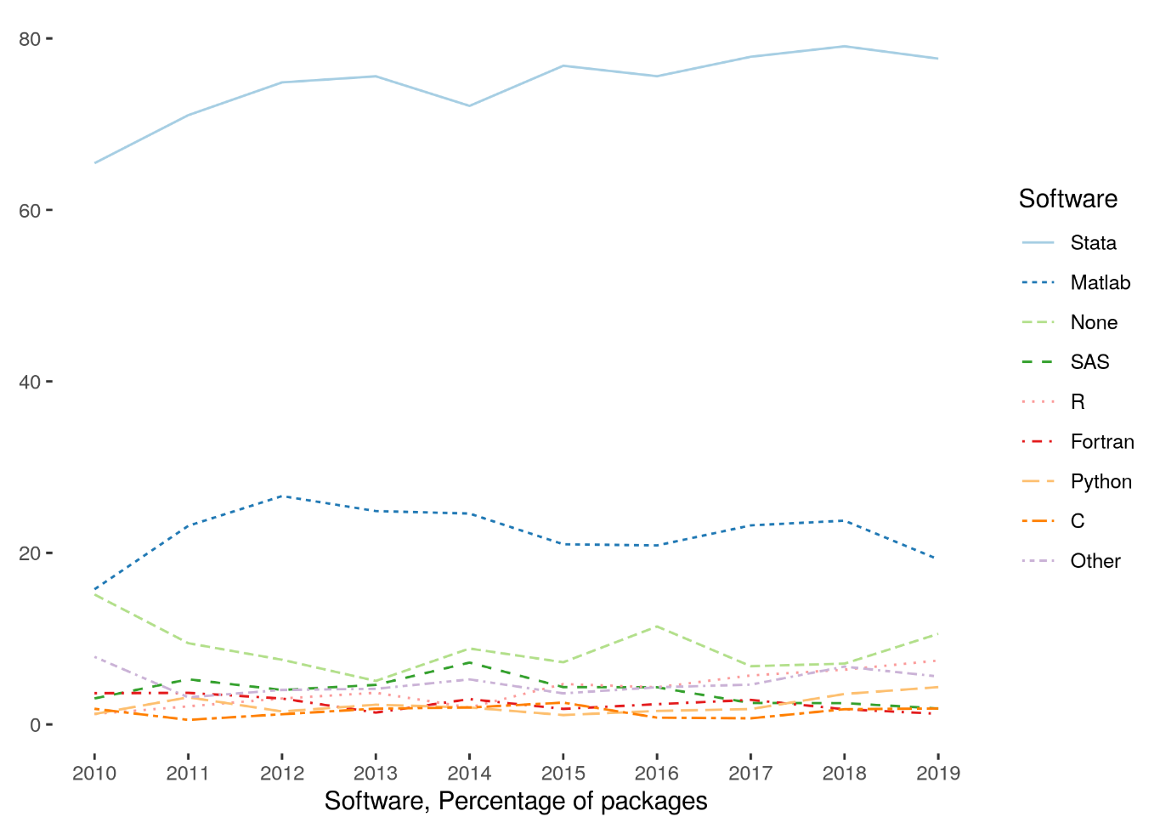
Stats on reproduced articles
Between July 16, 2019, and yesterday, the AEA Data Editor team conducted
~1156 assessments
for ~675 manuscripts
Stata is the most popular statistical software in the journals of the AEA (72.96% of all supplements)
followed by Matlab (22.45%)

Slide 10
Themes
Importance of tiered access
Recognition that not all data can be made “public”
How to better handle access requests
Support for private datasets
Importance of non-academic data providers (commercial, ad-hoc)
Importance of university data retention policies and infrastructure
Meta-repositories
Or: how to see all deposits that relate to a journal’s articles
APIs:
Better information about deposits
Easier computational integration

Slide 11
AEA Data & Code Availability Policy (2019)
It is the policy of the American Economic Association to publish papers only if the data used in the analysis are clearly and precisely documented and access to the data and code is clearly and precisely documented and is non-exclusive to the authors.
Authors of accepted papers that contain empirical work, simulations, or experimental work must provide, prior to acceptance, the data, programs, and other details of the computations sufficient to permit replication, as well as information about access to data and programs.

Slide 12
AEA Pre-Publication Verification
Every paper that receives a “conditional acceptance” is verified
Data citations
Quality of README (Data Availability Statement)
Quality of code
Reproducibility of code
Quality of metadata in the repository

Slide 13
Data citation and provenance analysis
Report on
provenance and data citations
Request for evaluation
Report on
computational reproducibility
Conduct reproducibility check
Can we access all the data?
Do we know how/
somebody who can?
Contact
third party
Conducts reproducibility check
Conduct
Code
check
Report on
potential reproducibility

Slide 14
Restricted-access data
Between 20% and 40% of papers have some sort of access restrictions
NDA (but Data Editor allowed)
DUA + IRB (in principle possible, but not quickly)
Click-through license with redistribution restriction (often not respected)
Commercial data

Slide 15
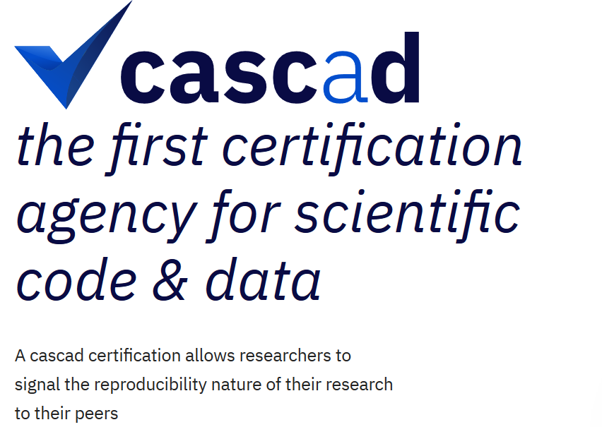


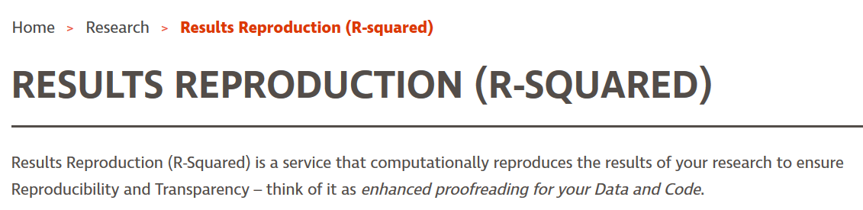
We work with 3rd parties
cascad – Using confidential data!
DADS
French customs data
CISER (R-Squared)
Various contributors with access to confidential data
Authors
Their institutions
Network of known groups with access (less frequent)

Slide 16
Themes
IRBs need to recognize role of replicators
Agreements (DUA, NDA, Licenses) need to incorporate the possibility of legitimate 3rd party access
Repositories need to efficiently handle legitimate access requests
Possibly pre-publication
Not just for editors
Importance of tiered access
Recognition that not all data can be made “public”
How to better handle access requests
Support for private datasets
Importance of non-academic data providers (commercial, ad-hoc)
Importance of university data retention policies and infrastructure
Meta-repositories
Or: how to see all deposits that relate to a journal’s articles
APIs:
Better information about deposits
Easier computational integration
Fine-grained permissions
Delegated pre-publication access (not just editors)

Slide 17
Themes
Importance of tiered access
Recognition that not all data can be made “public”
How to better handle access requests
Support for private datasets
Importance of non-academic data providers (commercial, ad-hoc)
Importance of university data retention policies and infrastructure
Meta-repositories
Or: how to see all deposits that relate to a journal’s articles
APIs:
Better information about deposits
Easier computational integration

Slide 18
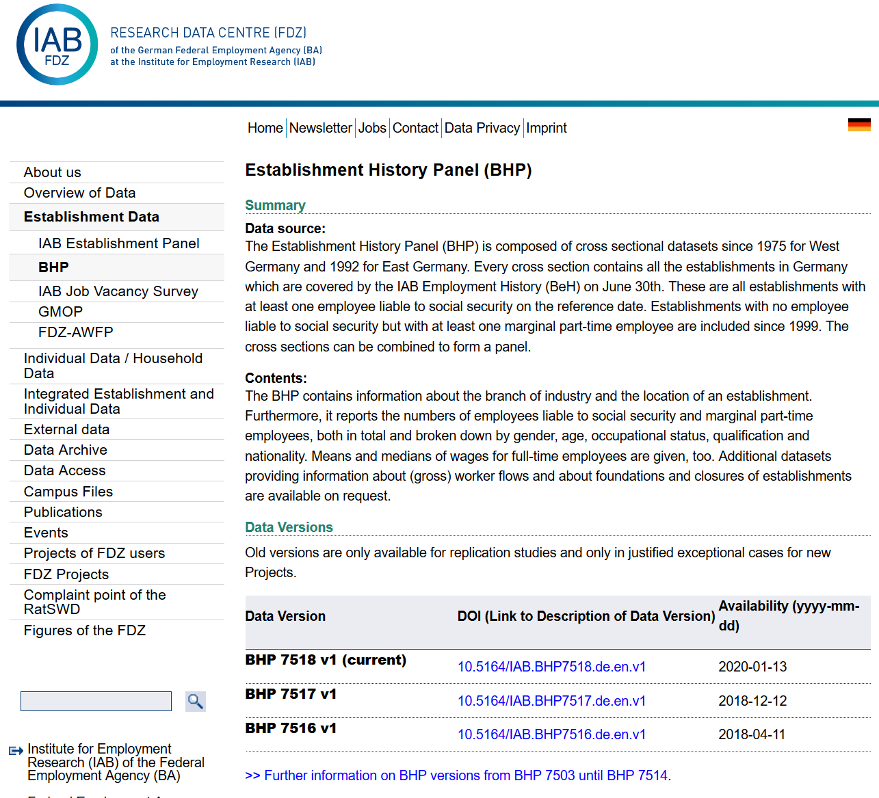
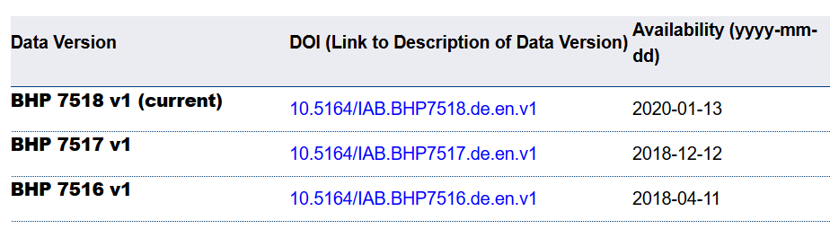
Non-repository institution: German Restricted-access

Slide 19
Citing restricted-access data
“Well, I can’t download the data, so I can’t cite it.”

Slide 20
A role for institutions?
Pitch:
Institutions can (must?) provide infrastructure for archives
Internal-only (dark)
Internal with public metadata (FAIR!)
Public
Mix of the above
Institutions provide researchers with information (citation, access protocols)
University
Data Retention Policies!
Notes:
Add logo from AEA

Slide 21
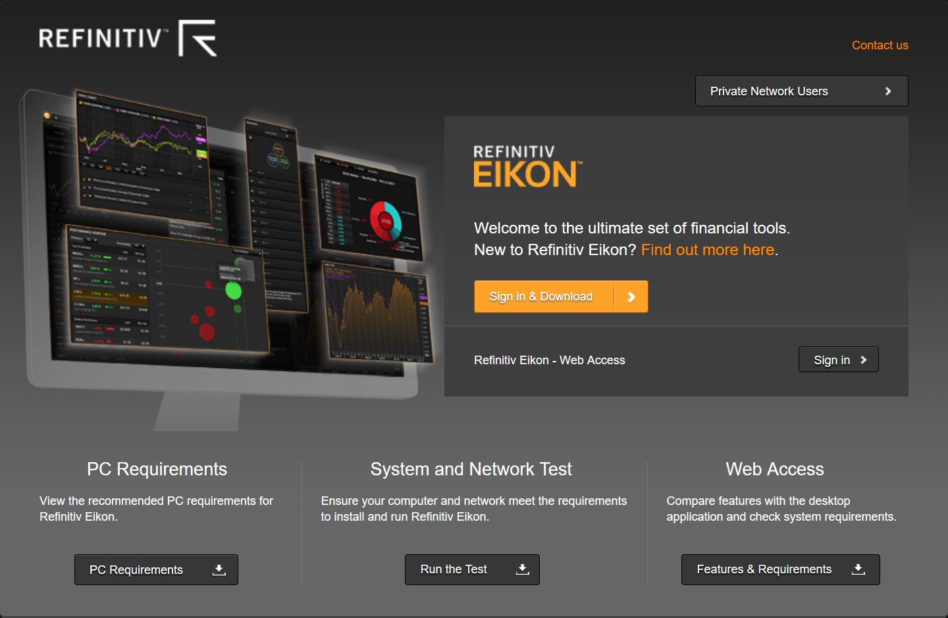
How did you get the data in first place?
You applied for the data through a process
You purchased the data from a provider
You signed an Non-Disclosure Agreement (NDA) with a company
Your university has an agreement with a data provider
…

Slide 22
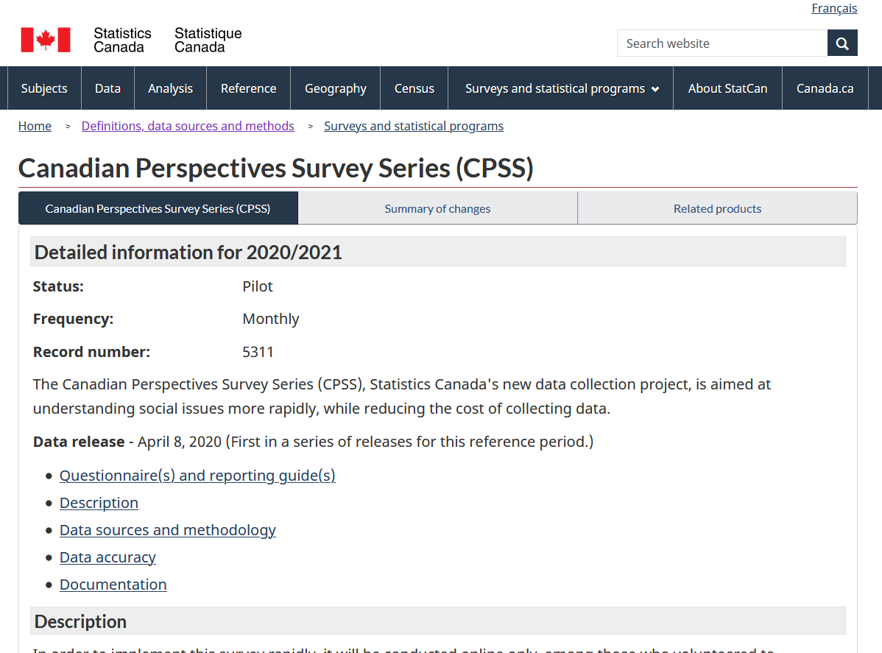
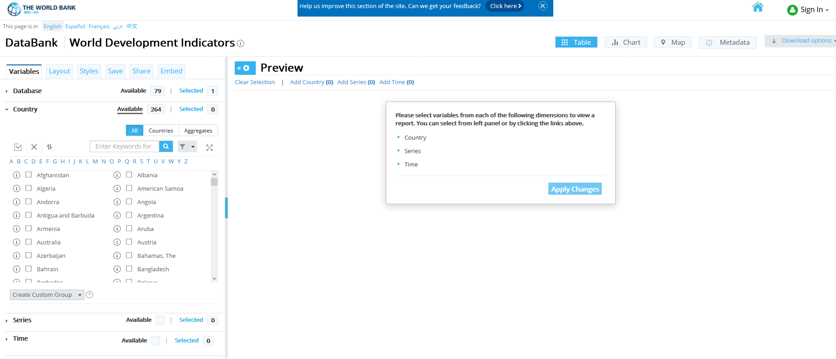
You must have described the data
You must have named the dataset you wanted
You downloaded the data from from an online query system
You specified the extract from a company database (in words, in SQL, etc.)
…

Slide 23
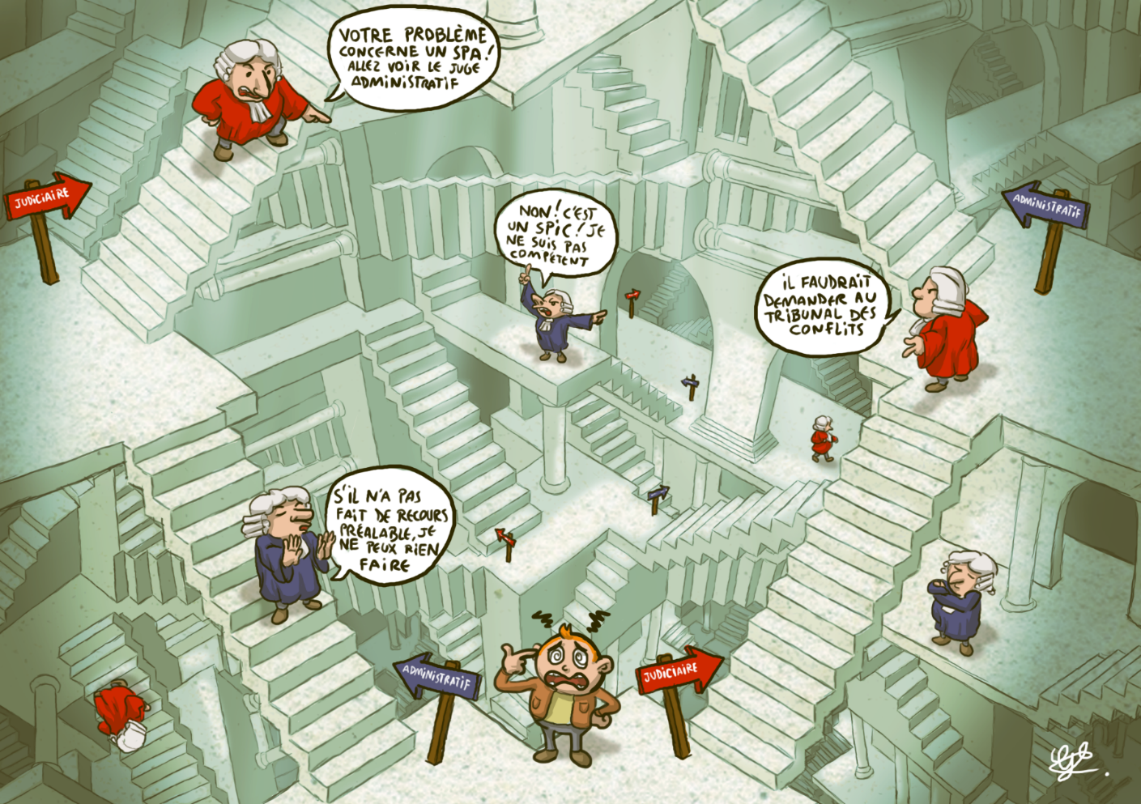
A role for institutions?
Institutions (data librarian!) can provide researchers with
The necessary information about original sources
Conveying the necessary access information
Arrange for permission to redistribute extracts
Data providers can
Provide suggested citations
Be clear about original sources!
Information about persistence
Potentially be clearer about the rights to redistribute
Notes:
Add logo from AEA

Slide 24
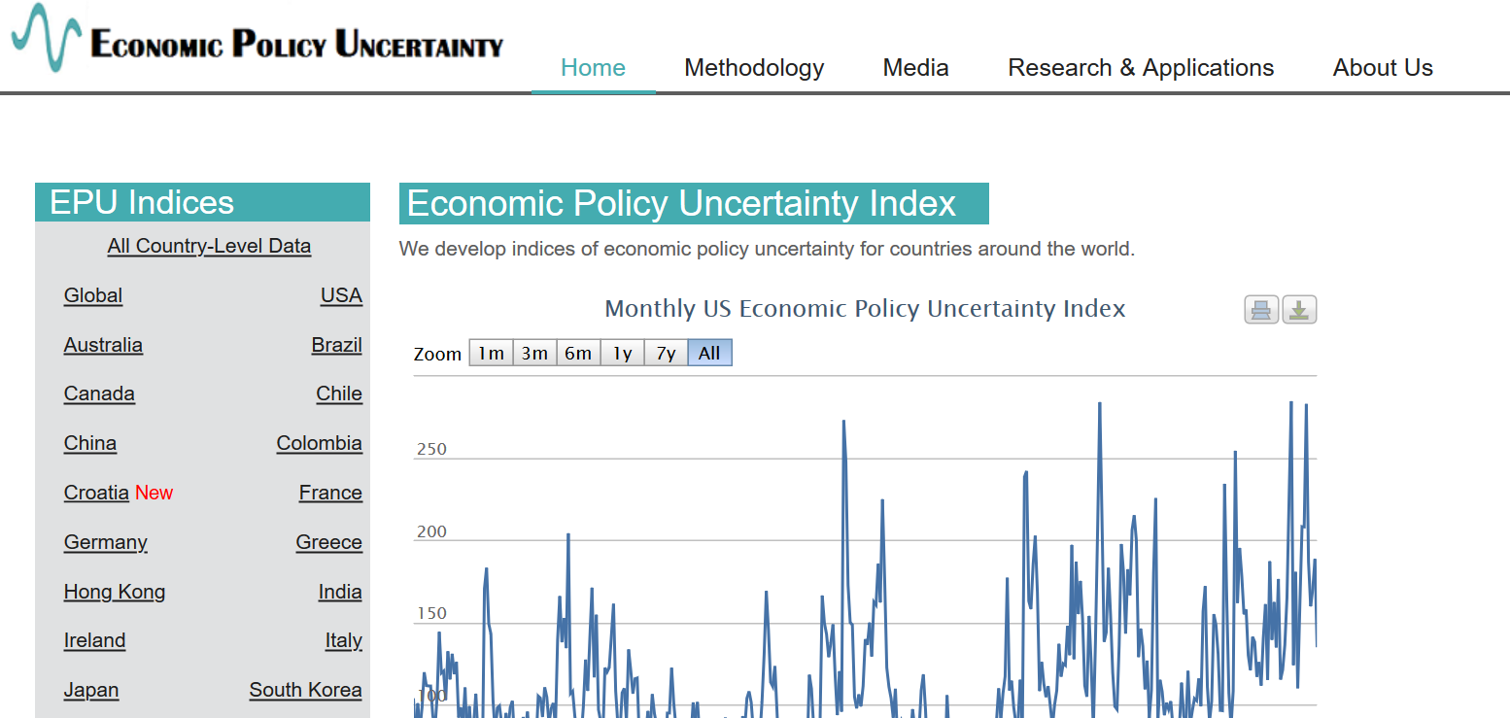
(Semi-)Academic data publishers

Slide 25
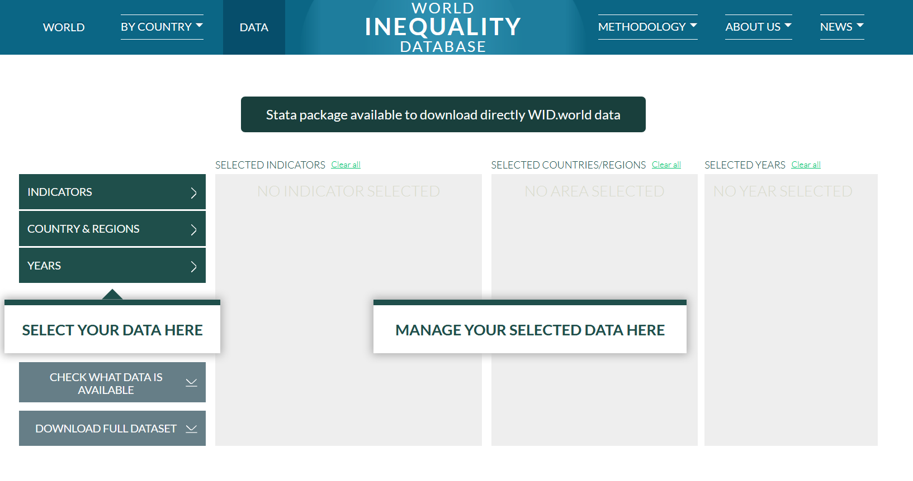
(Semi-)Academic data publishers

Slide 26
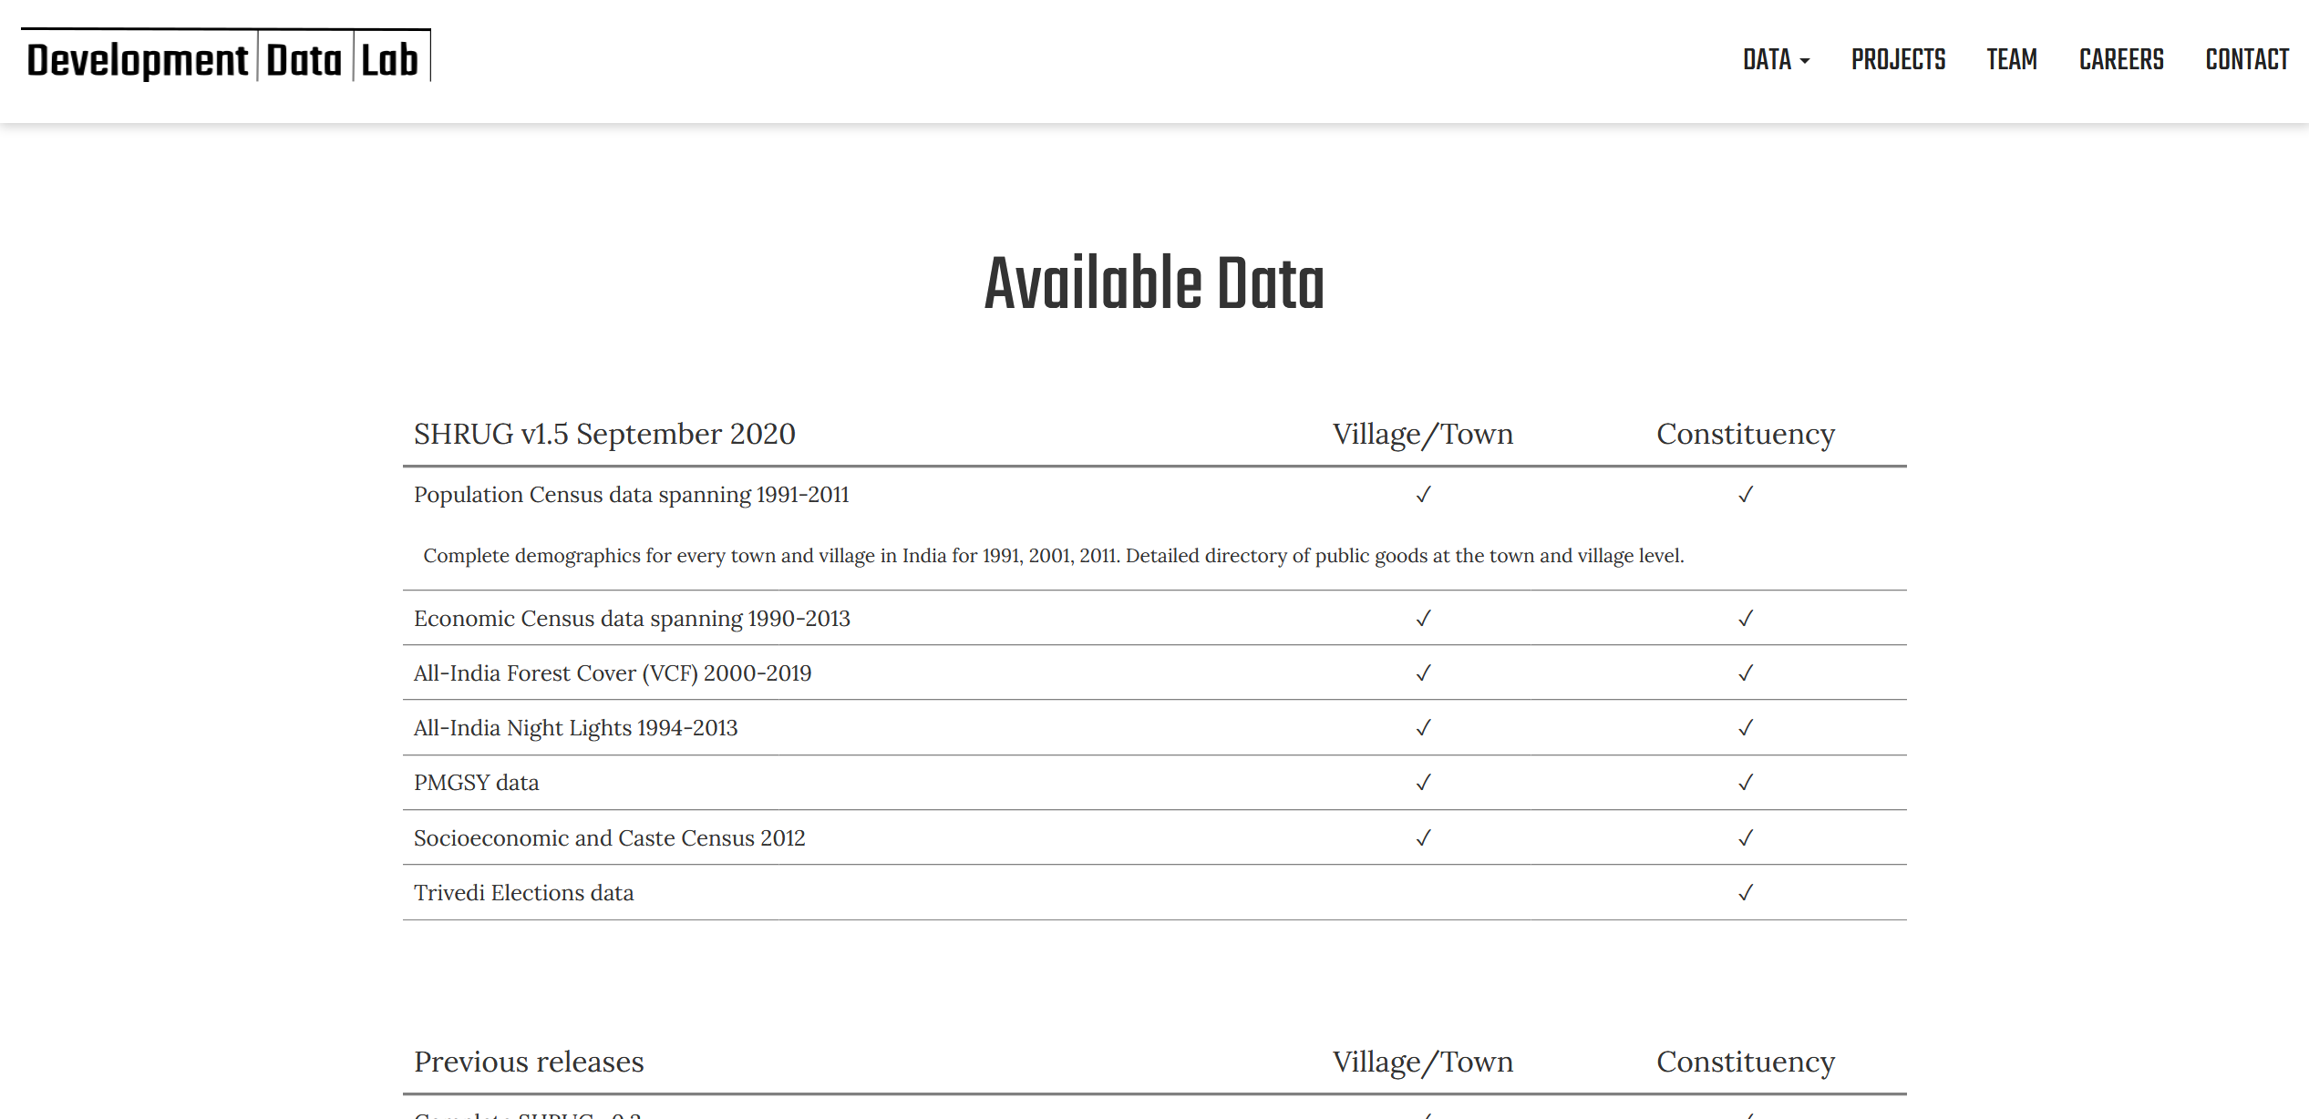
(Semi-)Academic data publishers

Slide 27
(Semi-)Academic data publishers
Only one of those three uses a trusted repository for preservation
And it is not the largest/best-funded…
All are lead by university (economists)
Bring them into the fold?

Slide 28
Themes
Universities need to create/support this
SOMEBODY needs to more consistently message to commercial/ non-archive repositories the need to
Preserve
Describe
Non-Repositories that provide widely used data need to get their act together (some already have!)
Importance of tiered access
Recognition that not all data can be made “public”
How to better handle access requests
Support for private datasets
Importance of non-academic data providers (commercial, ad-hoc)
Importance of university data retention policies and infrastructure
Meta-repositories
Or: how to see all deposits that relate to a journal’s articles
APIs:
Better information about deposits
Easier computational integration

Slide 29
Themes
Importance of tiered access
Recognition that not all data can be made “public”
How to better handle access requests
Support for private datasets
Importance of non-academic data providers (commercial, ad-hoc)
Importance of university data retention policies and infrastructure
Meta-repositories
Or: how to see all deposits that relate to a journal’s articles
APIs:
Better information about deposits
Easier computational integration

Slide 30

API integration
Data provider
(Social Science)
Repository
Manual or API
download
Manual
download

Slide 31
API integration
BONUS!!
Preservation + DOI
Data provider
API
upload
(Social Science)
Repository
API/ authenticated
download
API/ authenticated
download

Slide 32
Themes
You have to have APIs
You have to have person-level machine-authentication
Ability to list individual files
Ability to interact with computational systems
Importance of tiered access
Recognition that not all data can be made “public”
How to better handle access requests
Support for private datasets
Importance of non-academic data providers (commercial, ad-hoc)
Importance of university data retention policies and infrastructure
Meta-repositories
Or: how to see all deposits that relate to a journal’s articles
APIs:
Better information about deposits
Easier computational integration

Slide 33
Themes
Better support for “mixed” deposits (data + code)
Importance of tiered access
Recognition that not all data can be made “public”
How to better handle access requests
Support for private datasets
Importance of non-academic data providers (commercial, ad-hoc)
Importance of university data retention policies and infrastructure
Meta-repositories
Or: how to see all deposits that relate to a journal’s articles
APIs:
Better information about deposits
Easier computational integration

Slide 34
Themes
Importance of tiered access
Recognition that not all data can be made “public”
How to better handle access requests
Support for private datasets
Importance of non-academic data providers (commercial, ad-hoc)
Importance of university data retention policies and infrastructure
Meta-repositories
Or: how to see all deposits that relate to a journal’s articles
APIs:
Better information about deposits
Easier computational integration

Slide 35
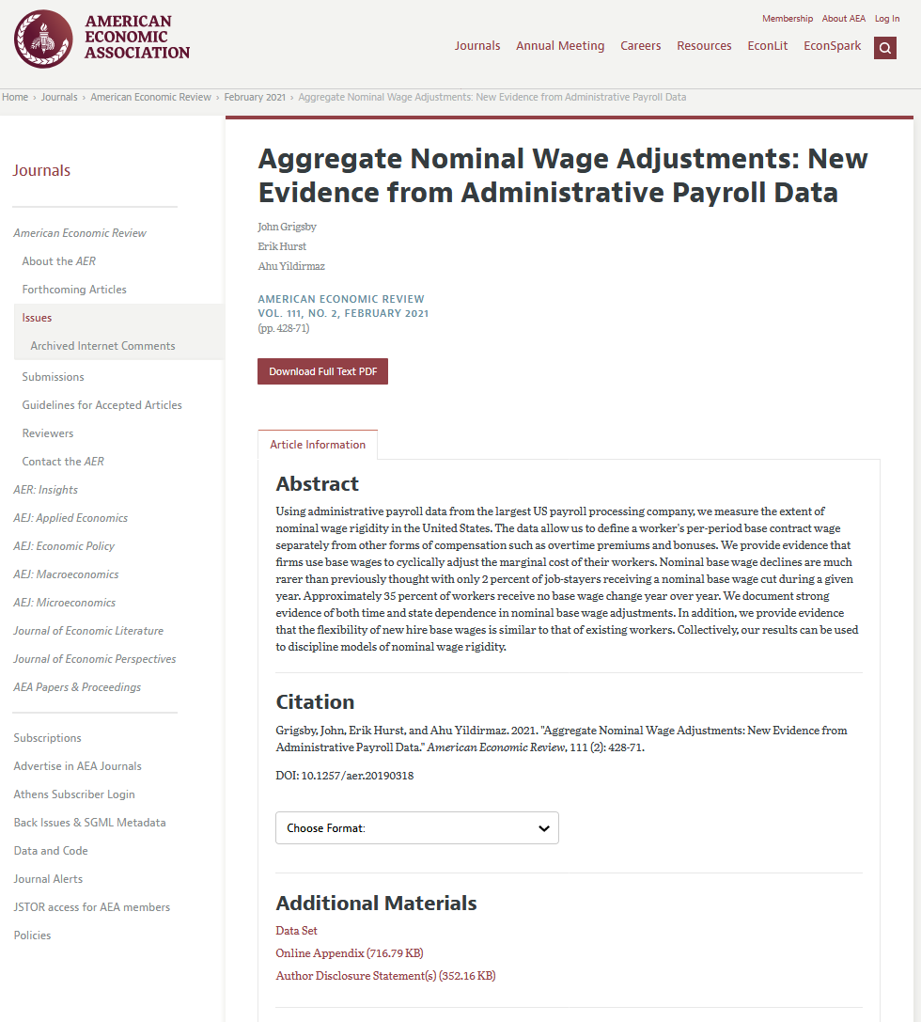
Dispersed
Private data at University X
German data at IAB
IPUMS data
Survey data at PSID
Survey data at GSOEP
Code at openICPSR
DOI?
DOI!
DOI! (Mmmh…)
No DOI
DOI!
DOI!
Fake example!

Slide 36
This is what data citations should do!
Select *
Where ( C.Relation = “isSupplementedBy”,
C.RelationID = D.DOI,
C.Journal = “AER” )
from CrossRef as C,
DataCite as D,
Order by C.DOI
Supplements for AER:
Dataset A (for Article 1)
Code C (for Article 1)
Private data (for Article 2)
German data (for Article 2, 5 ,7)
…

Slide 37
But standard data citations don’t
Citation link is not supplement link

Slide 38
Themes
Journals need to code (and report) richer relations
Repositories need to display dynamic relations (reward good journal reporting behavior)
Authors may need to contribute to linking
Non-repository data providers need to create DOIs, support data citations
Importance of tiered access
Recognition that not all data can be made “public”
How to better handle access requests
Support for private datasets
Importance of non-academic data providers (commercial, ad-hoc)
Importance of university data retention policies and infrastructure
Meta-repositories
Or: how to see all deposits that relate to a journal’s articles
APIs:
Better information about deposits
Easier computational integration

Slide 39
The role for journals

Slide 40
Goal: Transportability
Any standards, tools, methods: must be transportable across journals (no custom solutions)

Slide 41

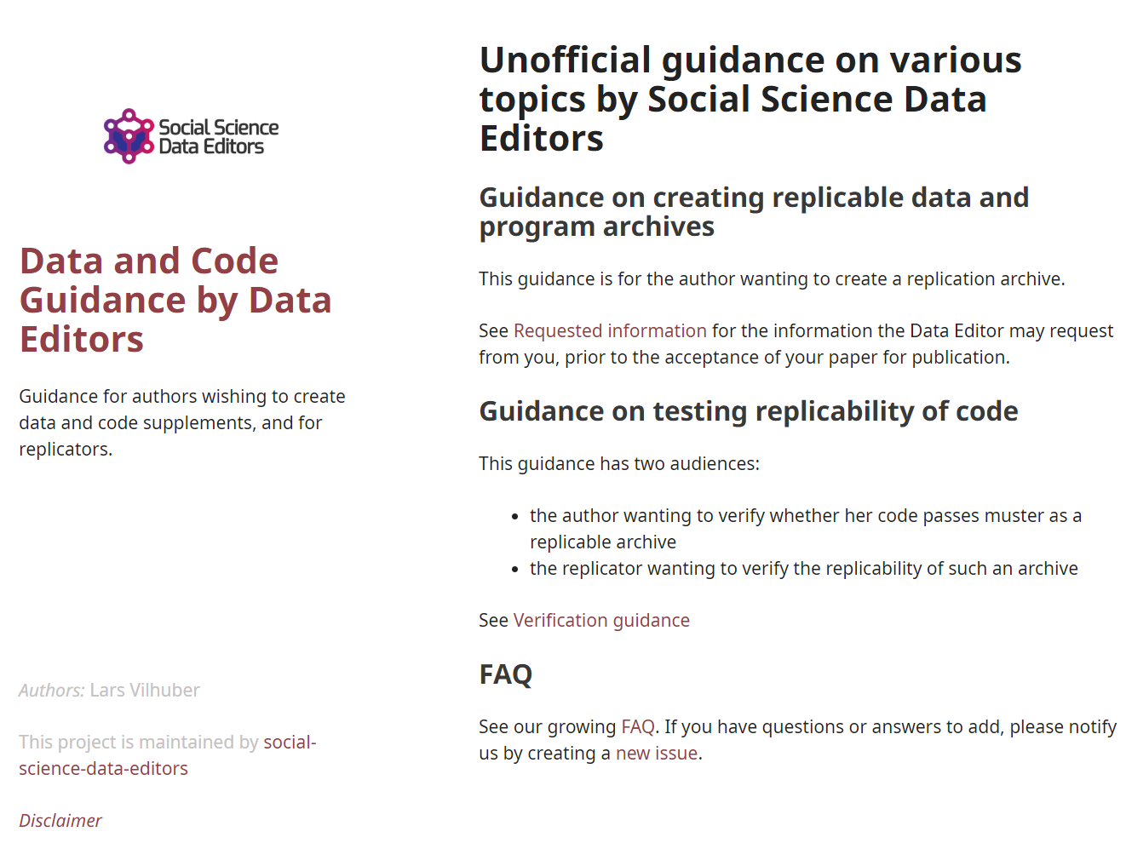
Social science “guild”
https:// social-science -data-editors. github.io/ guidance/

Slide 42
Thank you!

